Slide 1
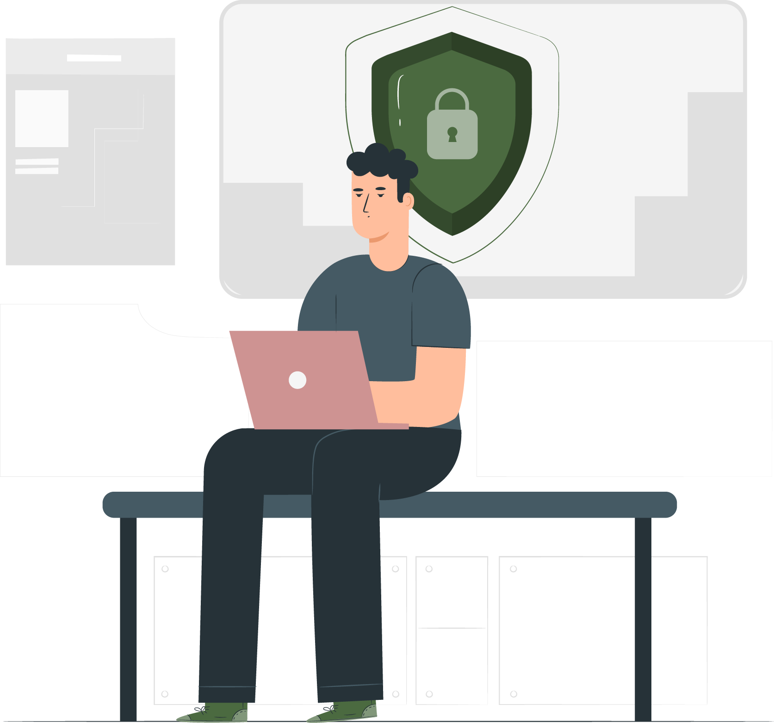
An Introduction to GDPR in AA

Slide 2
Introduction
This training is specifically designed for you to understand how GDPR impacts our work and how we can ensure we're protecting the privacy of everyone we interact with.
So, what exactly is GDPR? In simple terms, it's a set of rules that gives individuals more control over their personal data. It applies to any organisation that processes the personal data of individuals within the European Economic Area (EEA) and the UK. Even though we're not a commercial entity, we still handle personal data, making GDPR relevant to us.

Slide 3
Key Principles of GDPR
GDPR is built on several key principles.:
Lawfulness, Fairness, and Transparency: We must have a legal basis for processing data and be open about how we use it.
Purpose Limitation: We can only collect data for specific, legitimate purposes.
Data Minimisation: We should only collect the data we absolutely need.
Accuracy: Data must be accurate and kept up to date.
Storage Limitation: We should only keep data for as long as necessary.
Integrity and Confidentiality (Security): We must protect data from unauthorised access or loss.

Slide 4
What is Personal Data?
Names, addresses and email addresses
Phone numbers
Any data that can identify someone
Critically, criminal records are special category data, and have extra rules

Slide 5
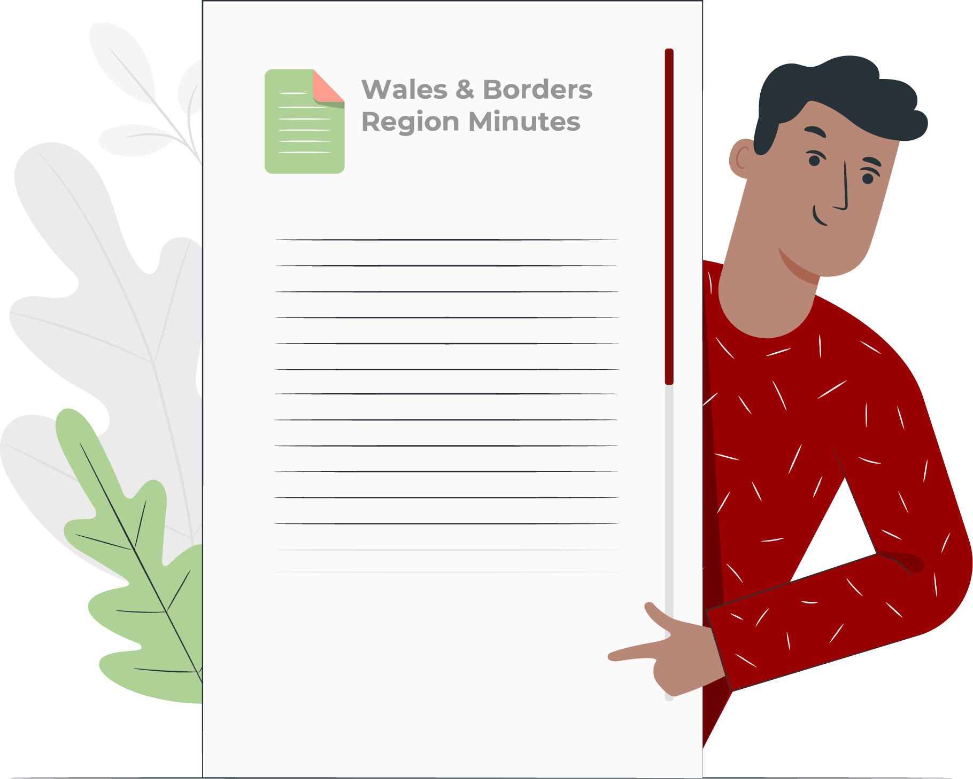
Why GDPR Matters to Us
Why does this matter to us as regional servants? Because we handle personal data in various ways:
Maintaining contact lists
Organising events and workshops
Communicating with members
Handling sensitive information

Slide 6
Common GDPR Scenarios for AA Servants
Scenario 1: Contact Lists: How do we collect and store contact information? Do we have consent? Is the data secure?
Scenario 2: Event Registration: When people register for events, what data do we collect? How long do we keep it?
Scenario 3: Email Communication: Are we using secure email practices? Are we sending mass emails responsibly? Do we use the BCC field when appropriate?
Scenario 4: Meeting Minutes: What information is being recorded? Are we protecting sensitive information?
Scenario 5: Handling Criminal Records: This is very sensitive. We must not record or distribute this information unless there is a very clear legal basis.

Slide 7
Practical Tips for GDPR Compliance
When taking meeting minutes, anonymise sensitive data.
Obtain clear consent when required.
Only collect necessary data.
Keep data up to date.
Respond promptly to data subject requests.
If in doubt, ask!
Store data securely.

Slide 8
Responding to a Data Breach
In the unfortunate event of a data breach, we must act quickly.
Assess the severity of the breach.
Notify the relevant authorities if required.
Inform the affected individuals.
Document the breach and the actions taken.
Remember, we must address the incident within 72 hours.

Slide 9
Resources and Support
You are not alone. You can find further guidance and support below.
You can also contact your Region or Intergroup ECLOs.
AA GSO GB GDPR Guidance
AA GSO GB Data Protection Policy
ICO Website

Slide 10

Thanks
Please feel free to contact us with any questions or feedback on this presentation.
www.aawalesandborders.org
secretary.wb@aamail.org
Image credit to: storyset.com

