Slide 1

This is a presentation
To Employers
Notes:
These are notes

Slide 2

What is Alcoholics Anonymous ?
Alcoholics Anonymous is a fellowship of people who share their experience, strength and hope with each other that they may solve their common problem and help others to recover from alcoholism.
The only requirement for membership is a desire to stop drinking. There are no dues or fees for AA membership; we are self-supporting through our own contributions.
AA is not allied with any sect, denomination, politics, organization or institution; does not wish to engage in any controversy; neither endorses nor opposes any causes. Our primary purpose is to stay sober and help other alcoholics to achieve sobriety.

Slide 3
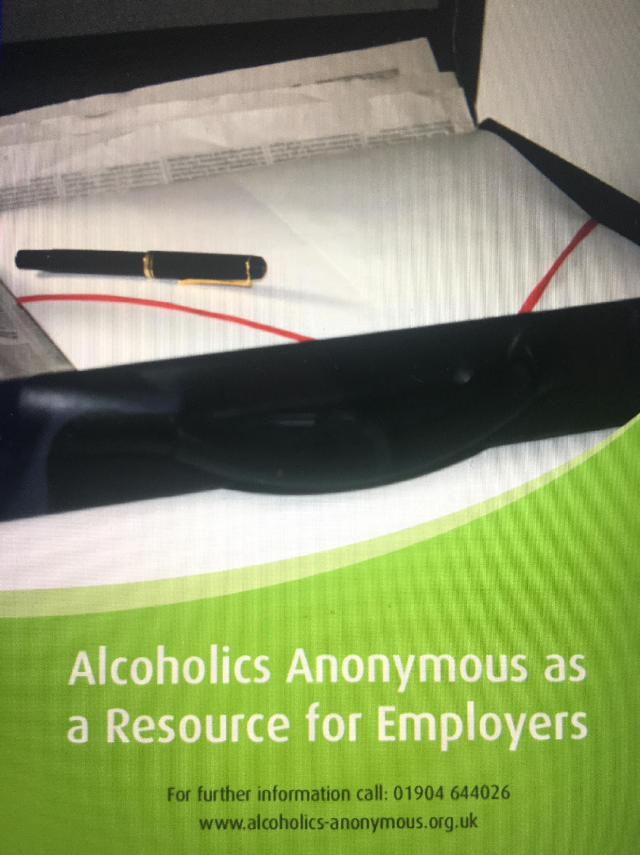
Alcohol Problems for Employers
Many of us have witnessed the difficulties that problem drinkers create for their employers for example:
Declining standards of work with lower output
Absenteeism
High levels of sick leave
Health & Safety Risks they pose to themselves and others
Many industries see alcoholism as a very wasteful overhead
They will be encouraged to find that AA does not cost them either time or money.
They see the advantages of a sober worker who attends AA and will often display and make available AA literature.

Slide 4
What is AA?
Alcoholics Anonymous is a fellowship of men and women who share their experience strength and hope with each other that they may solve their common problem and help others to recover from alcoholism
It started in the US in 1935 and now has over 2 million members in 150 countries

Slide 5
How does AA work?
We view alcoholism as a progressive illness
We see it as a threefold condition – physical, mental, spiritual
We believe that alcoholics of our type have lost the power to control their drinking
We believe that AA and the 12 step program of recovery, works to overcome the condition

Slide 6
What is an AA meeting?
Group members get together once or twice a week
“Closed” meetings – Members who think they have a drink problem
“Open” meetings – Anyone who is interested in AA
Each meeting is completely autonomous and so they vary
Each meeting is self-supporting
4,000+ meetings nationwide.

Slide 7
What are the 12 steps?
They are a recovery programme for living alcohol free
Principles are based on actual recovery experiences of early members
It is on-going program, which we choose to continue to follow throughout our lives

Slide 8
The Twelve Traditions
Are suggested principles to ensure the survival and growth of groups and A.A. as a whole.
Tradition Eleven- ‘Our public relations policy is based on attraction rather than promotion; we need always maintain personal anonymity at the level of press, radio and films.’

Slide 9
Who can join AA?
The only requirement for membership is a desire to stop drinking.

Slide 10
How much does AA cost?
It’s free.
There are no dues or fees for AA membership, we are self-supporting through our own contributions.

Slide 11
How can we help?
All professionals are welcome to attend our “open” meetings.
I can be point of contact for any employers and employees, dealing with still-suffering alcoholic
We can speak at any company event
Literature and posters are available via the AA website shop at any time when requested

Slide 12
Employment Video
Alcoholics Anonymous Video on Employment
https://www.alcoholics-anonymous.org.uk/Professionals/Videos-for-Professionals

Slide 13
Questions?

Slide 14
Chapter 10 – To Employers
Alcoholics Anonymous
“No man should be fired just because he is alcoholic. If he wants to stop, he should be afforded a real chance.”

Slide 15
Help for the Alcoholic in the Workplace
National AA Telephone Helpline 0800 9177 650
Email help@aamail.org
Instant Messaging Service https://www.alcoholics-anonymous.org.uk/About-AA/Newcomers/Get-help-now

Slide 16
General Service Office
P.O. BOX 1, 10 TOFT GREEN, YORK, YO1 7NJ
TEL NO: 01904 644026
www.alcoholics-anonymous.org.uk

Slide 17
End of presentation
Employment

