Slide 1

Employment Liaison
A Presentation for AA Members on Employment Liaison

Slide 2
Employment Liaison – What is it? Why is it Important?
Since the early days of our Fellowship, AA has sought to carry its message to Employers, hence Chapter 10 of the “Big Book” Alcoholics Anonymous.
Why did Bill find it necessary to write a chapter to employers?
This chapter suggests to the leaders of large companies to give the drunks in their ranks a chance to get well, to see if they want a sober way of life, rather than firing them first. The point is emphasized that it takes money to train employees, especially management positions. This chapter gives a new alternative for employers dealing with alcoholism. Rather than simply firing an employee, they can be given an opportunity to get sober first by going to AA. This was very much new thinking when the ‘Big Book’ was first published.
In Great Britain the General Service Conference has considered since 1982, how best to carry the message to the workplace in a structured way.
Intergroups and Regions support and appoint Employment Liaison Officers at local level to carry the message to Employers

Slide 3
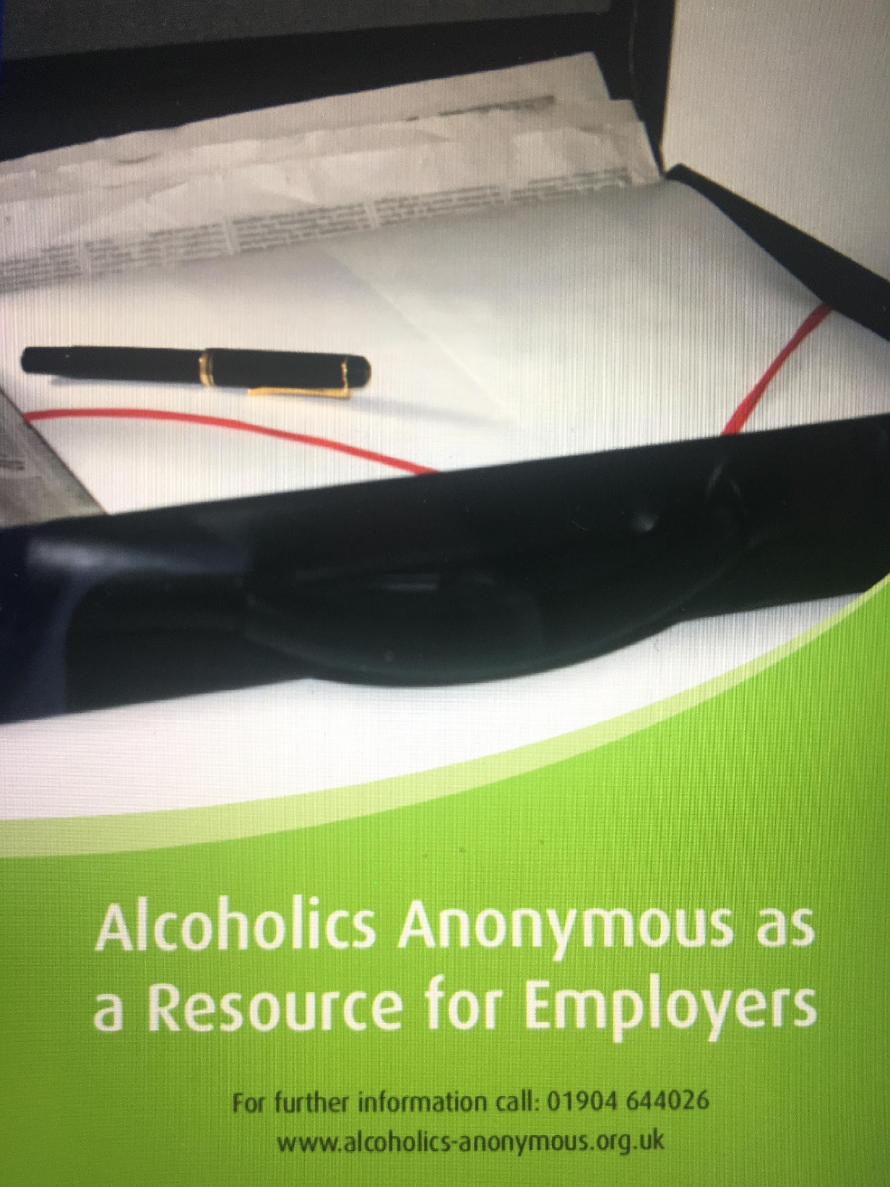
Why do Employers Need to know about AA?
Many of us have witnessed the difficulties that problem drinkers create for their employers for example:
Declining standards of work with lower output
Absenteeism
High levels of sick leave
Health & Safety Risks they pose to themselves and others
Many industries see alcoholism as a very wasteful overhead
They will be encouraged to find that AA does not cost them either time or money.
They see the advantages of a sober worker who attends AA and will often display and make available AA literature.

Slide 4
What do Employment Liaison Officers do? (1)
Carry AA’s message to Employers** within their local area supported by intergroup and region
** Employment specifically concerns carrying the message to any organisation employing or serving staff companies, trade unions and associations, government departments and/or related agencies.
Can work with PI on joint activities
Provide a stand at a Convention or Forum

Slide 5
What do Employment Liaison Officers do? (2)
How have other ELO’s carried the message to Employers?
Working with local job centres
Established contact with the West York’s Police via P.I. activities
Organised meeting for fifty GPs
Much work taking place with H.R. departments in railways
Focus on large employers found they are referring to employer’s assistance programs
Large hotels are seen as good potential employers in some regions
Good contact established with the Metropolitan Police in London
Contact is being established with heads of HR in major construction companies

Slide 6
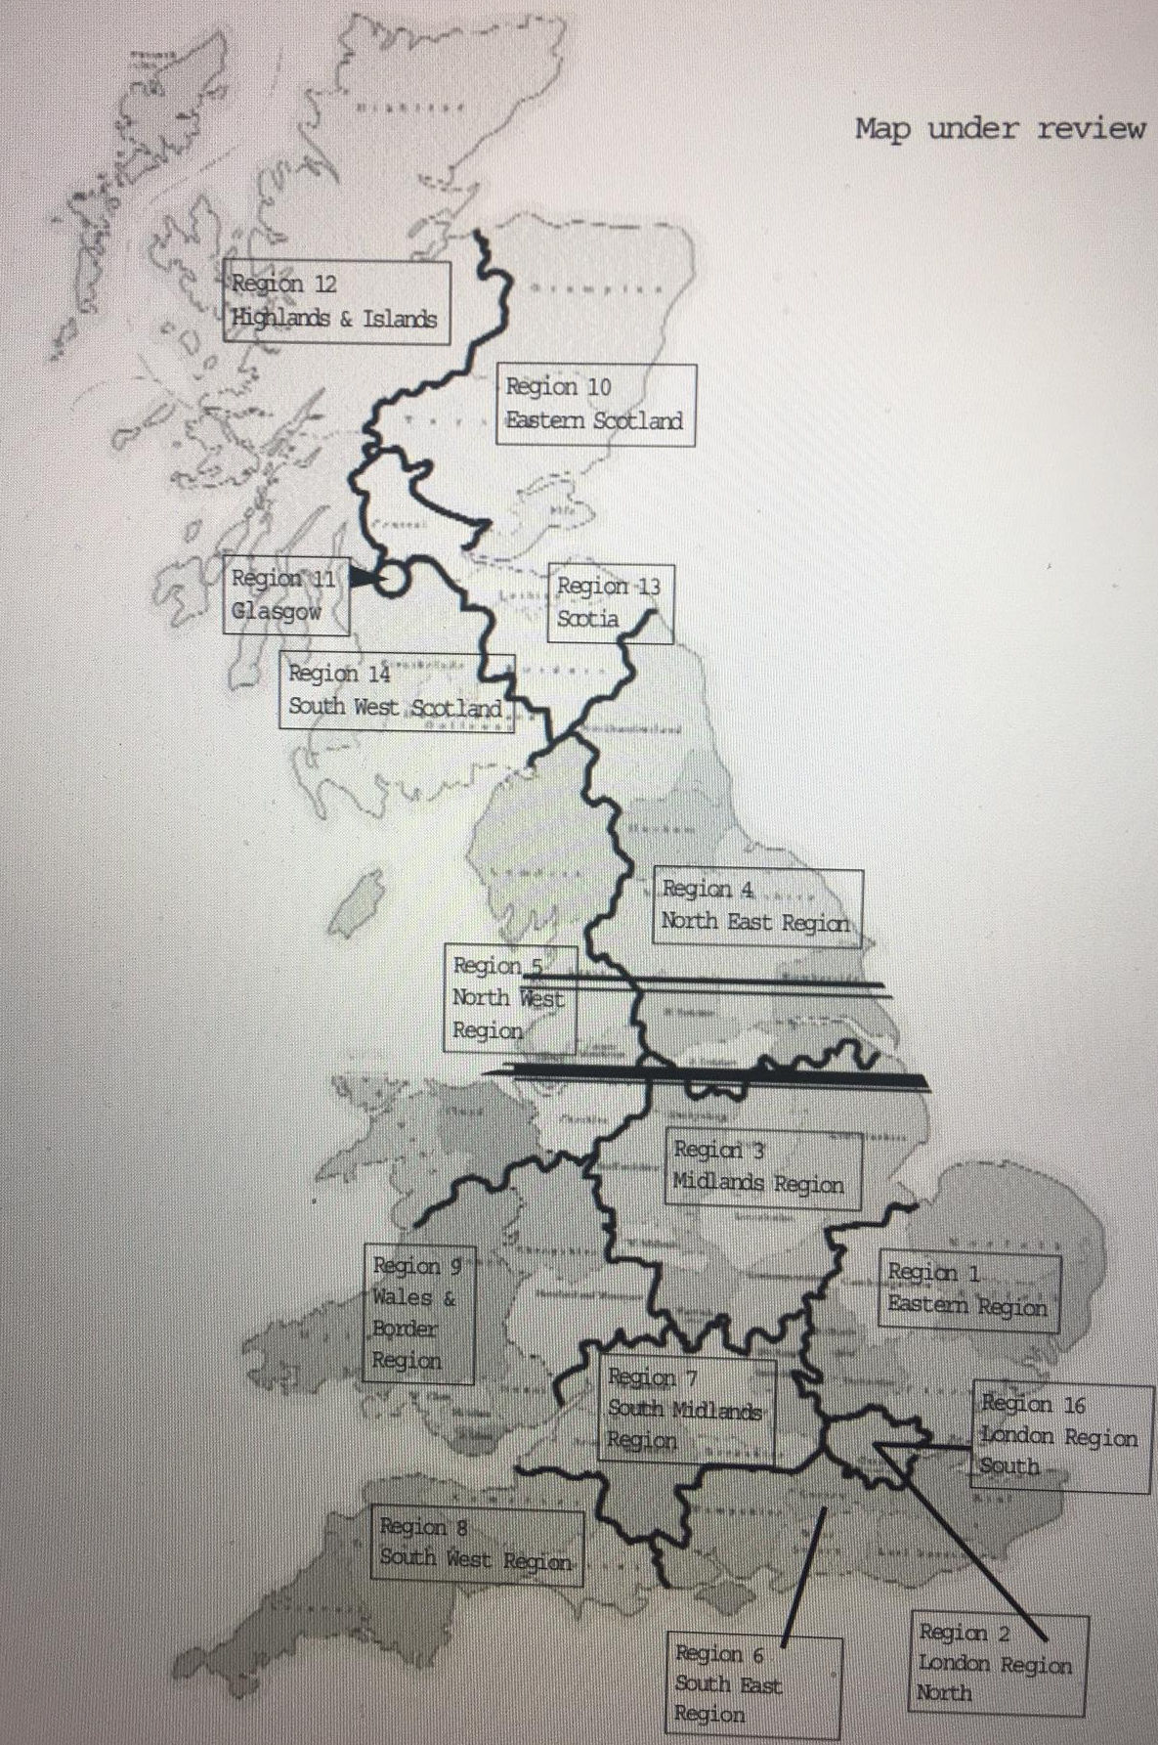
Employment Liaison in AAGB
Region
Highlands and Islands
Eastern Scotland
Scotia
Glasgow
South West Scotland
North East
North West
Midlands
Eastern
Wales and Borders
South Midlands
London South
London North
South East
South West
Continental European

Slide 7
The Employment Sub-Committee – What do we do?
Establish and maintain good relations with professionals and professional bodies connected within Employment.
Offer support and advice to ELO’s.
Help promote and encourage the appointment of Liaison Officers.
Review and update literature, media resources and guidelines as necessary.
Organise the annual Regional Liaison Officers meeting held in York. The purpose is to inform the Fellowship what we are doing
Develop, update and maintain a resource pack for all ELO’s
Produce a bi-annually E-letter – Hello ELO
Be responsible for the Employment section on the AA GB website
Promote good communication with the Board

Slide 8
Tools to help with Employment Liaison
The Employment Sub-Committee ………..
The Employment Liaison Resource Pack – provides everything you need to know on how to carry the AA message to Employers
The AA Service and Structure Handbooks for Great Britain – free of charge from GSO – or available in the document library on the AA Website
The Employment Section on the AA Website - https://www.alcoholics-anonymous.org.uk/Professionals/Employment
A range of literature for example:
  Alcoholics Anonymous as a Resource for Employers
  How AA Members Co-operate with Professionals
  For Literature downloads visit here: https://www.alcoholics-anonymous.org.uk/Professionals/Employment/Literature-Downloads
The AA Employment Video – available on the AA website

Slide 9

What do YOU need to be an ELO
An established period of sobriety (ideally not less than two years)
A good knowledge of the AA Service & Structure Handbooks for Great Britain
Willingness to commit to not less than two years’ and not more than three years’ service
The ability to deal with a range of professional people and talk about AA when invited to do so - these qualities have proven to be desirable

Slide 10
If YOU would you like to get involved in Employment Liaison
Pick up the phone and talk to me / other Liaison Officers
Attend the Annual Regional Employment Liaison Officers meeting – to hear how other members are doing in Employment Liaison
Put the date in your Calendar
9th – 10th June 2023

Slide 11
Employment Video
https://www.alcoholics-anonymous.org.uk/Professionals/Videos-for-Professionals

Slide 12

Any Questions

